Slide 1

Bioinformatics IH7001 Introduction to Medical Research Dr Wilson Goh School of Biological Sciences

Slide 2
What we will be covering
Differentiating Bio-informatics and Bio-Data Science
A primer on logic
What are confounders?
The Anna Karenina Principle
A final word on biomarker identification and validation
A short introduction on exploratory data analysis and the grammar of graphics (Swirl Tutorial)

Slide 3
Differentiating Bioinformatics and Bio-Data Science IH7001 Introduction to Medical Research Dr Wilson Goh School of Biological Sciences

Slide 4
Qn: What do you think differentiates an IT personnel and a Computer Scientist?
Open discussion

Slide 5
Bioinformatics
This is simply information technology applied on the biological domain
It is meant to be a support discipline and therefore does not have a core body of concepts that is stable and invariant
An example of a stable and invariant core concept in biology is the “Central Dogma of Biology”
Professional requirements in Bioinformatics changes according to the prevalent technology popular at the time
During the early 2000s, bioinformaticians with skills in sequence alignment and microarray analysis technologies were in demand
Currently, given the popularity of new proteomics and genomics technologies, these bioinformaticians who failed to upgrade are no longer in demand

Slide 6
Computational Biology
Computational Biologists are essentially biologists who have acquired sufficient bioinformatics skills to help with them their research question
The bioinformatics knowledge still plays a support function. But the core strength in this group of specialists is their intimate knowledge of biology and lab techniques
The bioinformatics skill set is synergistic
Examples of people in this group are genomicists, proteomicists, or scientists who run both dry and wet-lab components in their laboratories

Slide 7
A new breed --- Bio-Data Science
Data Science is the new hot discipline
It is essentially a science of prediction --- it is about creating actionable insight based on objective analysis on reasonable sized data
Data Science is a discipline based on 3 core areas --- the domain knowledge (which can be business, finance, logistic, etc), computer science, and mathematics/statistics
Data Science focuses on prediction using machine learning models and artificial intelligence
Given the large amount of data that exist in biology today, we anticipate the rise of the Bio Data Scientist as a new breed

Slide 8
So what is relevant in bioinformatics?
It is more useful to go through the thinking process than to teach an algorithm as trivial as sequence alignment (which you may or may not use)
We will look at Peircian logic and what it means in terms of biomarker research
We will look see that it is very easy to reject the null hypothesis due to the Anna Karenina Principle.
Finally, we will go through some design principles for making better representation of data for the purpose of analysis and communication
Bonus: We will have some R code tutorials for rapid immersion and practical hands on

Slide 9
A primer on Logic IH7001 Introduction to Medical Research Dr Wilson Goh School of Biological Sciences

Slide 10
What is logic?
Logic is a system for distinguishing between correct and incorrect arguments.
Arguments --- not people fighting. An argument is a chain of reasoning that leads towards a conclusion.
Logic includes a set of principles that when applied to arguments, allows us to demonstrate what is true/false.

Slide 11
An example of an argument
All men are mortal.
Socrates is a man.
Therefore, Socrates is mortal.
In this case, the first 2 statements are premises, with the third being the conclusion.

Slide 12
An example of an argument
Let’s look at another example of an argument:
There’s a draught in the room.
A window is open.
Therefore, the draught is coming from the window.
Are the premises correct?
Is the conclusion necessarily correct?
What if the door is also open?

Slide 13
Premises
A premise --- what you already know, or assume to be true. Note that just because you assume it is true, does not mean it is necessarily so.
It amounts to an answer of ‘true’ or ‘false’ (A truth value).
Statements that are premises:
All men are mortal. (true or false)
There’s a draught in the room. (true or false)
Statements that are not premises:
Break a leg
What time is it?

Slide 14
The value of logic in scientific reasoning
Applying logic is a way of developing and testing a hypothesis.
Using this way of thinking, applying logic assumes you already know something for sure.
And you use that knowledge to arrive at some further conclusions.

Slide 15
Three types of Reasoning
There are 3 major forms of logical reasoning.
Induction
Abduction
Deduction
1
2
3
Some forms of reasoning are stronger than others.

Slide 16
What is Induction? IH7001 Introduction to Medical Research Dr Wilson Goh School of Biological Sciences

Slide 17
Induction
In inductive reasoning, the conclusion need not follow exactly from the premises (i.e., the conclusion is breakable). There is always a chance that it may not. Let us consider the first example.
In this example, we generalise to a law based on 2 attributes found on the entity, Socrates. Since Socrates is both a man and is mortal, we conclude that all men are mortal. This conclusion is true, for as long as no counter examples are observed.
Tip: Inductions often takes the form of bottom up reasoning. That is, reasoning from observations towards a law.
Induction
Socrates is a man
Socrates is mortal
All men are mortal, provided there is no counter example
Notes:
For example, we observe that a person named Peter is both a man and immortal. This automatically invalidates the conclusion, as being a man, does not automatically imply, being mortal.

Slide 18
Induction
While it is easy to remember or think of induction as “bottom up” (creating laws from observation) while deduction is “top down” (making conclusions based on laws).
It is important to note that not all forms of inductive reasoning takes this form. Let us look at another example:
A bag contains 99 red balls and 1 black ball
100 people each drew one ball from the bag
Sarah is one of those 100 people
Therefore, Sarah probably drew a red ball
Notice in this example, premises need not be limited to only 2 statements. On top of that, there is the aspect of probability involved as well.
In this case, Sarah likely drew a red ball with a probability of 99%. However, we cannot assure that this conclusion (that she got a red) is guaranteed.

Slide 19
Other Forms of Induction
Premise 1: All swans we have seen are white. (True)
Therefore all swans are white. (True/False?)
Counter example: A black swan was observed in Africa.
Note also that not all arguments need to have multiple premises.
Premise 1: These beans are from this bag. (True)
Premise 2: These beans are white. (True)
Therefore All the beans from this bag are white. (True/False?)
Counter example: Some green beans from this bag are discovered.

Slide 20
Can any signature predict breast cancer survival and its relation to inductive reasoning?
A paper by Venet et al claimed that after testing several non-breast-cancer gene signatures, any signature will do as well in predicting breast cancer survival.
Premise 1: Social defeat signature is predictive of survival outcome. (true)
Premise 2: Sneezing signature is predictive of survival outcome. (true)
Conclusion: All signatures can predict survival outcome.
Two additional signatures from schizophrenia were evaluated on the breast cancer data.
Signature | Size | p_val (P)
Schwarz | 147 | 0.45
Hess | 89 | 0.44
Neither were found to be significant for predicting breast cancer survival. So how do we evaluate this outcome?

Slide 21
Can any signature predict breast cancer survival and its relation to inductive reasoning
Would you conclude that any signature from any other disease can cross-predict breast cancer survivability?
Premise 1: Social defeat signature is predictive of survival outcome. (True)
Premise 2: Sneezing signature is predictive of survival outcome. (True)
Conclusion: All signatures can predict survival outcome.
The conclusion reached is incorrect.
Counter example: The schizophrenia signature cannot predict survival outcome.
Induction
Socrates is a man
Socrates is mortal
All men are mortal, provided there is no counter example

Slide 22
What is Deduction? IH7001 Introduction to Medical Research Dr Wilson Goh School of Biological Sciences

Slide 23
Deduction
Deduction is the strongest form of reasoning --- its conclusion must follow from its premises.
If the premises are true, then the conclusion must also be true.
1 and 2 are true, therefore the conclusion must be true.
Deductive reasoning has very strict standards. Not meeting any of these can result in failure.
A tip: Deductions often takes the form of top down reasoning. That is, reasoning from a law towards an observation.
Deduction:
1. All men are mortal.
2. Socrates is a man.
Socrates is mortal.

Slide 24
Deduction
How can deduction fail?
One of the premises could be false.
Premise 1 is false: not all dogs are brown.
Even though the statements above take the form of a deductive argument, it fails because one of the premises is false (“rubbish in, rubbish out”).
1. All dogs are brown.
2. Missie is a dog.
Therefore, Missie is brown.

Slide 25
Deduction
How can deduction fail?
The conclusion does not follow from the premises.
This argument fails because of faulty logic.
While it is true that all tennis balls are round, but so too are many other things!
1. All tennis balls are round.
2. The earth is round.
Therefore, the Earth is a tennis ball.

Slide 26
Deduction
Generalising deduction: You have seen the deductive argument in this form
All men are mortal.
Socrates is a man.
Therefore, Socrates is mortal.
We may express the form of this argument symbolically as follows:
All As are Bs.
C is an A.
Therefore, C is B.
To be able to conclude something deductively is relatively rare. It requires having laws with absolute truth values that are not easily broken (e.g. “All men are mortal” or “The sun will rise from the east”). Compare this to “laws” like “All swans are white”.

Slide 27
Deduction (bio example)
All enzymes belonging to class X performs function Y
We have a gene sequence Z that is 90% similar to genes in class X
Therefore, Z performs function Y

Slide 28
What is Abduction? IH7001 Introduction to Medical Research Dr Wilson Goh School of Biological Sciences

Slide 29
Abduction
Abduction seeks to find the simplest and most likely explanation/conclusion given a set of premises or observations.
Like induction, it is also breakable in the sense that the conclusion can be wrong, even if the premises are true.
Tip: Abduction involves generalisation via shared attributes.
Abduction
All men are mortal
Socrates is mortal
Socrates is a man, provided there is no other explanation of Socrates’ mortality
Notes:
In this example, we may start with a law, where men are said to be mortal. In other words, men is an entity, and mortal is an attribute. We observe the entity Socrates to also be a mortal.
Because Socrates has the attribute of being mortal, we say therefore, by abduction, he is a man. The abductive form of reasoning works, provided that there is no other explanation for Socrate’s mortality. Realise that Socrates does not need to be a man to be a mortal, the entity Socrates could also be an animal.
Hence, you should realise that logical inferences via abduction can easily lead to awkward situations.

Slide 30
Abduction
Using similar reasoning, let’s say that the fire truck is red.
We observe that an apple is also red.
Therefore, by abduction, the fire truck is an apple.
Obviously, there are other explanations for the fire truck’s redness. It was painted to be red.
Use abductive reasoning with care. It is valid, only if there are no other explanations that can explain the observation.

Slide 31
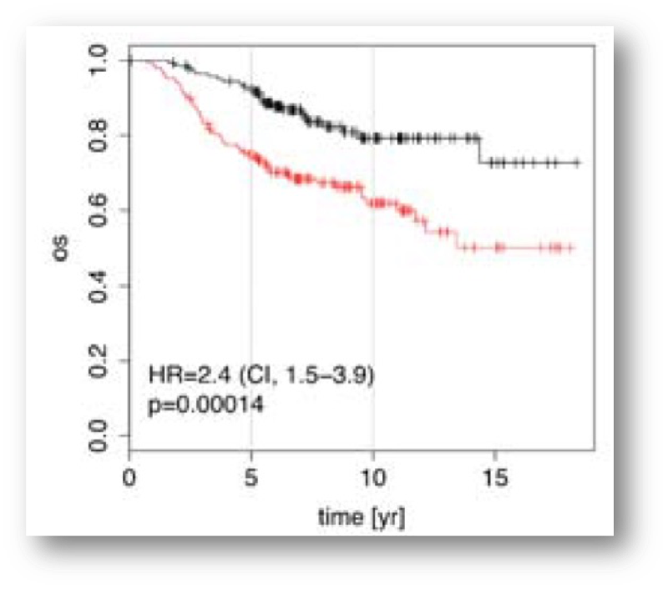
Survival Curve and Abductive Reasoning
Premise 1: Multi-gene signature for breast cancer is predictive of survival outcome. (true)
Premise 2: Multigene for social defeat is predictive of survival outcome. (true)
Therefore, social defeat signatures are breast cancer signatures. (false)
The conclusion reached is incorrect. This is because other explanations exists. And that has to do with the presence of confounders and widespread genome instability effects observed in cancer.
Abduction
All men are mortal.
Socrates is mortal.
Socrates is a man, provided there is no other explanation of Socrates’ mortality

Slide 32
Three Types of Reasoning
While deduction is the strongest form of reasoning, induction and abduction can also be powerful when the addition criteria is fulfilled.
1
2
3
Induction
Socrates is a man.
Socrates is mortal.
All men are mortal (provided there is no counter example).
Abduction
All men are mortal.
Socrates is mortal.
Socrates is a man (provided there is no other explanation of Socrates’ mortality).
Deduction
All men are mortal.
Socrates is a man.
Socrates is mortal.

Slide 33
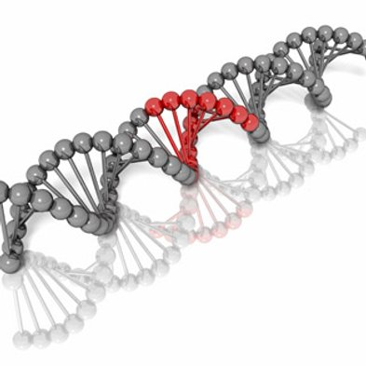
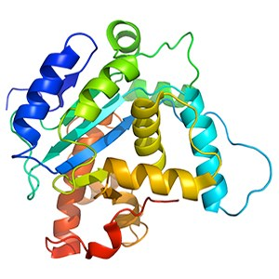

Which of the following are examples of each reasoning type?
Gene A performs function X; Gene B is sequentially similar to Gene A. Therefore, Gene B also performs function X.
An apple is red, a car is red, so therefore a apple is a car.
A class of proteins, C, performs function X. Protein Z is a member of C, so protein Z must therefore perform function X.
Notes:
In the second example, we are generalising an observation to a rule. So this is induction. This is escapable because not all genes similar to A must have same function.
In the final example, we start with a rule, and zoom down to an observation. This is inescapable there is no way to get out of this rule.

Slide 34
Which of the following are examples of each reasoning type?
Induction
Gene A performs function X; Gene B is sequentially similar to Gene A. Therefore, Gene B also performs function X.
Abduction
An apple is red, a car is red, so therefore a apple is a car.
Deduction
A class of proteins, C, performs function X. Protein Z is a member of C, so protein Z must therefore perform function X.
Notes:
In the second example, we are generalising an observation to a rule. So this is induction. This is escapable because not all genes similar to A must have same function.
In the final example, we start with a rule, and zoom down to an observation. This is inescapable there is no way to get out of this rule.

Slide 35
Practice
Deduction:
All the beans from this bag are white.
These beans are from this bag:
Therefore These beans are white.
Induction:
These beans are from this bag.
These beans are white.
Therefore All the beans from this bag are white.
Abduction:
All the beans from this bag are white.
These beans are white.
Therefore These beans are from this bag.
Is the conclusion always true when the premises are true?
Is the conclusion always true when the premises are true?
Is the conclusion always true when the premises are true?

Slide 36
Logic and prediction
You would have noticed by now that you may apply logical reasoning on biomarker prediction
And also on interpretation of statistical significance in the survival curve.
It is foolish to take a very superficial and naïve interpretation of whatever the computer program or statistical test returns you.
As a scientist you need to interpret data and findings very objectively and critically.
Bioinformatics should not be just about programming --- (Bio) Computer Science is no more about programming than biology is about petri-dishes.
You have earlier seen that interpretations of findings may be misled by the presence of confounders. We will go on next to discuss what these are.

Slide 37
What are Confounders? IH7001 Introduction to Medical Research Dr Wilson Goh School of Biological Sciences

Slide 38

A confounder is…
A confounder is a variable that can create spurious associations.
Let’s say you want to study whether eating sweets causes lung cancer. You only have smokers in your “eating sweets” category, and non-smokers in your “non-sweet eating” category, whether or not someone smokes then becomes a confounding variable (your study is likely to identify a spurious link between sweet eating and lung cancer).
A confounder is also referred to as a lurking variable in statistics.

Slide 39
Why should we care about confounders in bio data science?
Clinical/Biology samples are complex, and are different in many unexpected ways.
Imbalance in any of these ways (variables) may lead towards unexpected correlations (Anna Karenina Effect).
They may also lead towards non-detection of true signal (Loss of power).
Poor experimental design can lead towards horrifying situations where the variable of interest is completely entangled with a confounder (and cannot be disambiguated) --- this scenario is called perfect confounding.

Slide 40
The Idea of Perfect Confounding
Let’s say we want to know if drinking Yakult makes you taller. We design the following experiment:
Yakult Drinkers
Non-Yakult Drinkers
What is wrong here?

Slide 41
The Idea of Perfect Confounding
Yakult drinkers being tested are all male.
Males are in general, taller than females.
Therefore, we are likely to observe that Yakult drinkers are taller and therefore conclude that a correlation exists.
However, we cannot say for sure (do not forget that Yakult is full of milk calcium and nutrition and can in fact, aid growth).
In this case, because the Yakult and gender variables are completely mixed together in the same category, we cannot disentangle them. This situation is known as “perfect confounding”.
Note that not all unbalanced variables are confounders. The unbalanced variable must contribute towards the outcome of interest. For example, if the Yakult drinking group is composed entirely of biology students on one hand, and engineering students on the other, you may not care as much.

Slide 42
Remedies
Balanced Design
Remove the Confounder
Yakult Drinkers
Non-Yakult Drinkers
Yakult Drinkers
Non-Yakult Drinkers
In your opinion, which approach is better? Which approach is more feasible in real world practice?

Slide 43
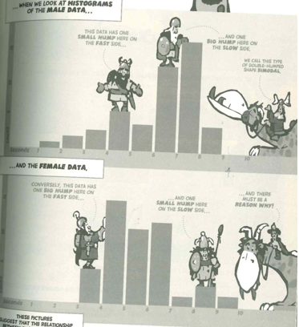
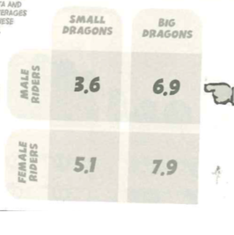
Hunting for Confounders
Use the Contingency Table
Graphs and Plots
Suspected confounder
Check for multi-modality of your data
Averages
Variable of Interest
Check that your results are consistent given any split of a ‘suspected’ confounder.
If you see multiple peaks, then there may be subpopulations (splitable by the confounder) in your data.

Slide 44
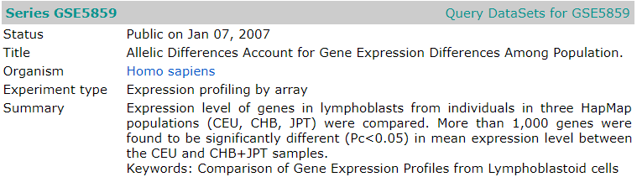
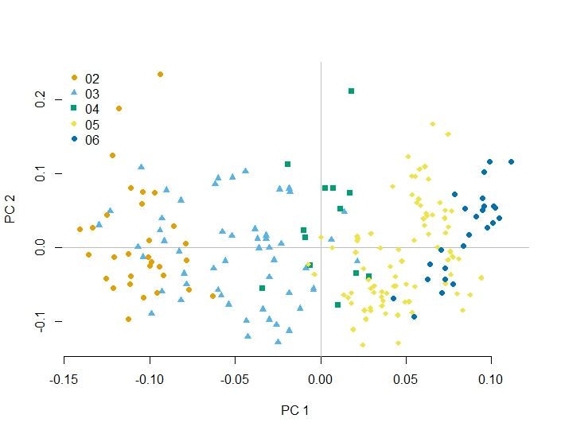
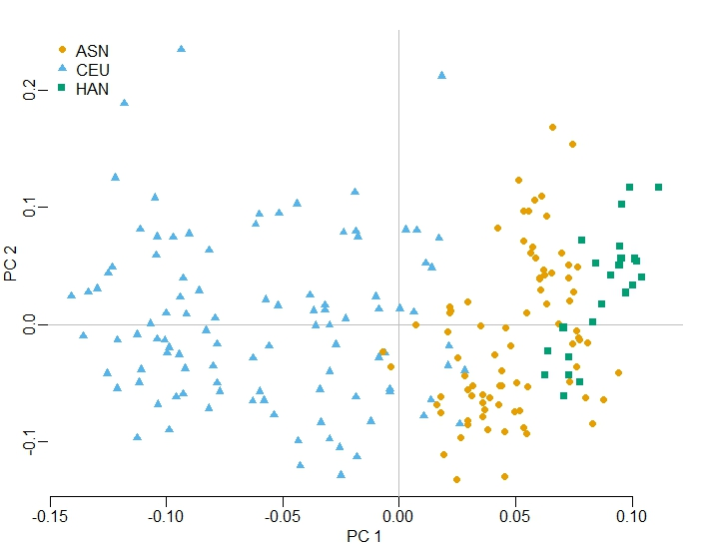
Thinking problem (30 minutes)
The following is representation of data obtained from the study below. What do you think is wrong with this study. (You do not need to know what PCA is specifically. You only need to know that it is a summary of total variation in data and that it is useful for summarizing the visualization of samples with thousands of variables into 2D plots). What do you make of the 1,000 differential genes identified in this study---Are they reliable?
2D PCA scatterplot (grouping by ethnic groups--- CEU = CEU, CHB=ASN, and JPT=HAN)
2D PCA scatterplot (grouped by data collection year --- 02 refers to years 2002, 03 to 2003 and so on)

Slide 45
Live Demo: Checking for confounders using R in your own data

Slide 46
Break

Slide 47
The Anna Karenina Principle IH7001 Introduction to Medical Research Dr Wilson Goh School of Biological Sciences

Slide 48
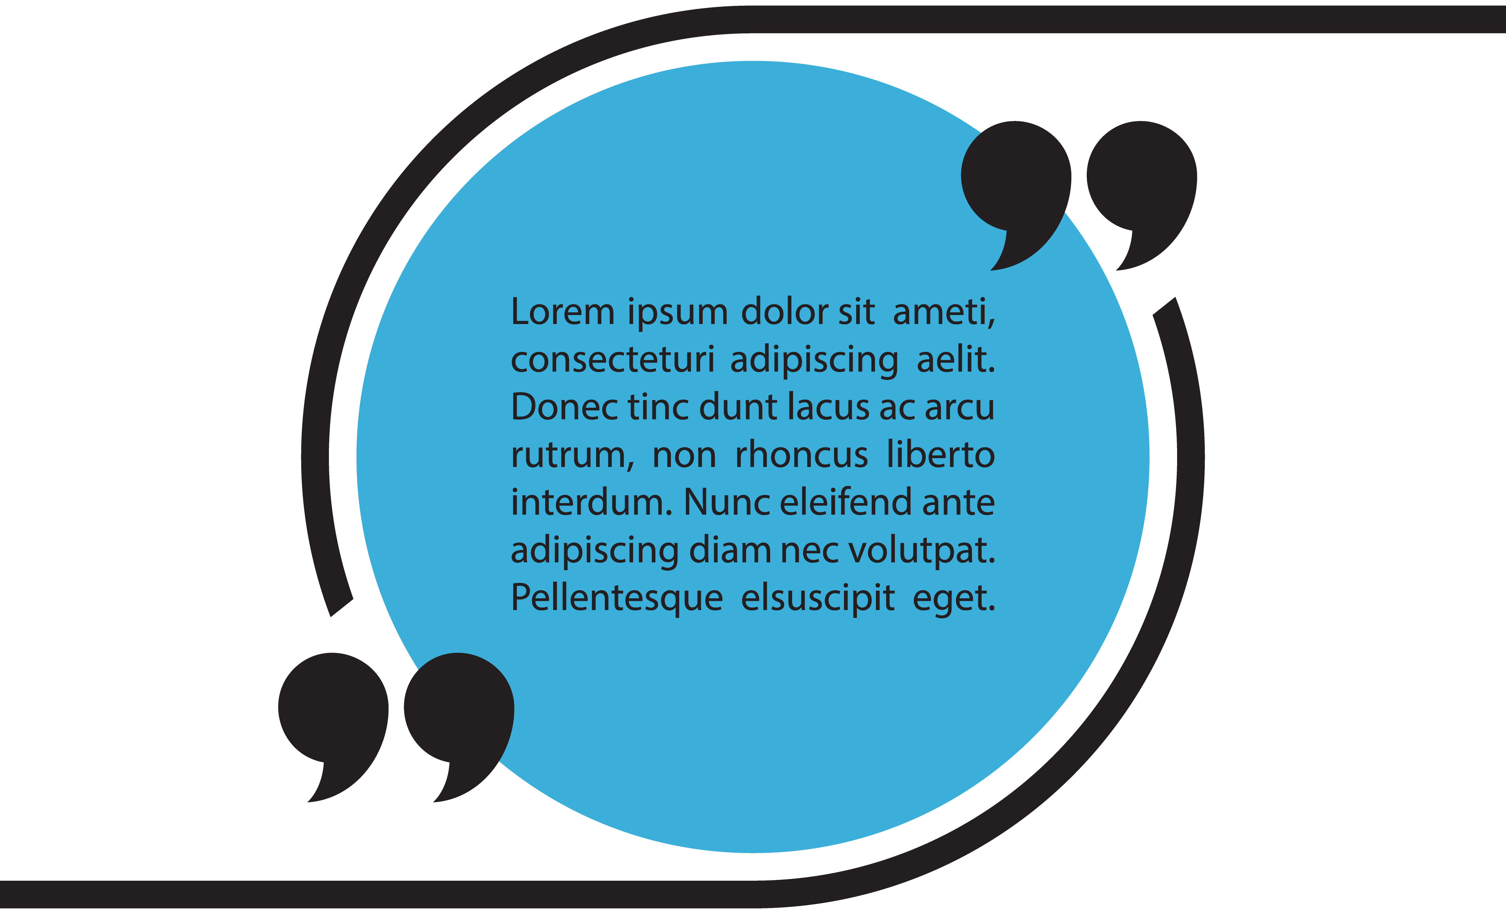
Anna Karenina Principle
Happy families are all alike; every unhappy family is unhappy in its own way.
~ Leo Tolstoy
Translation: There are many ways to violate the hull hypothesis but only one way that is truly pertinent to the outcome of interest.
Notes:
it means that when the null hypothesis is not rejected (happy families), there is little concern for any inherent differences (they all satisfy the same necessary requisites for happiness, of which there are many). However, if the null hypothesis is rejected (unhappy families), there are many possible reasons for this rejection, and it is unforgivingly suggested that failure in any one out of the many requisites leads to unhappiness. In biomarker development, although failure in any one requisite leads to rejection of the null (unhappiness), we are not interested in all of them. We are only interested in one requisite: when a gene is significant, it is because it is truly phenotypically relevant, and not because of random or technical or sampling bias, mis-stated null hypothesis, inappropriate nominal null distribution, etc. Unhappily, statistical significance alone as criterion for signature inclusion is insufficient.

Slide 49
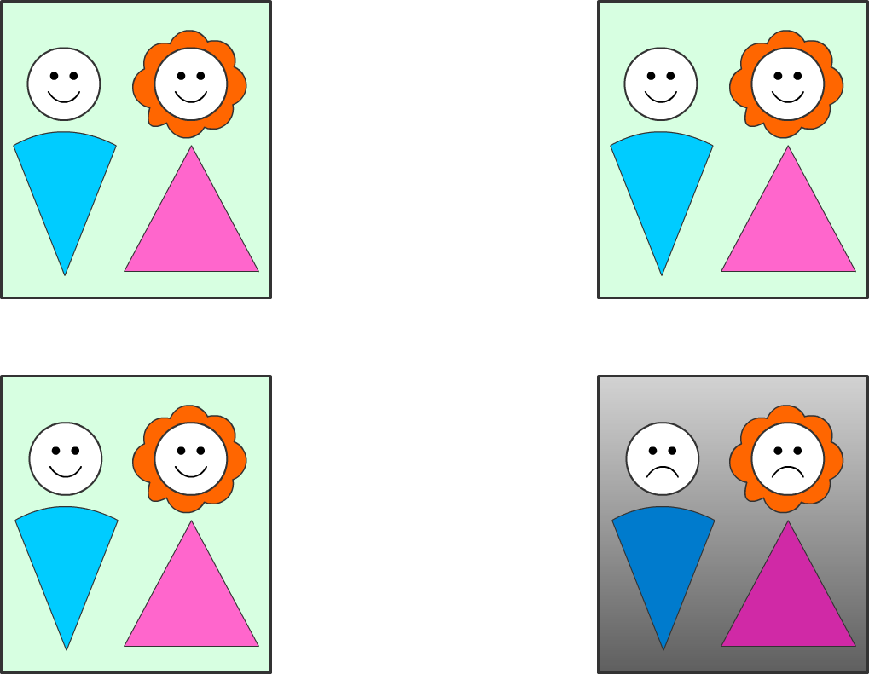
Setup for a Statistical Test
The elements of null hypothesis statistical testing.
Statistical test
True Negative/False Negative
Null Condition
No Effect (Gene is Irrelevant)
Null Condition Retained
Null Condition
Statistical test
True Positive/False Positive
No Effect (Gene is Irrelevant)
Null rejected (Gene may/may not be relevant)

Slide 50
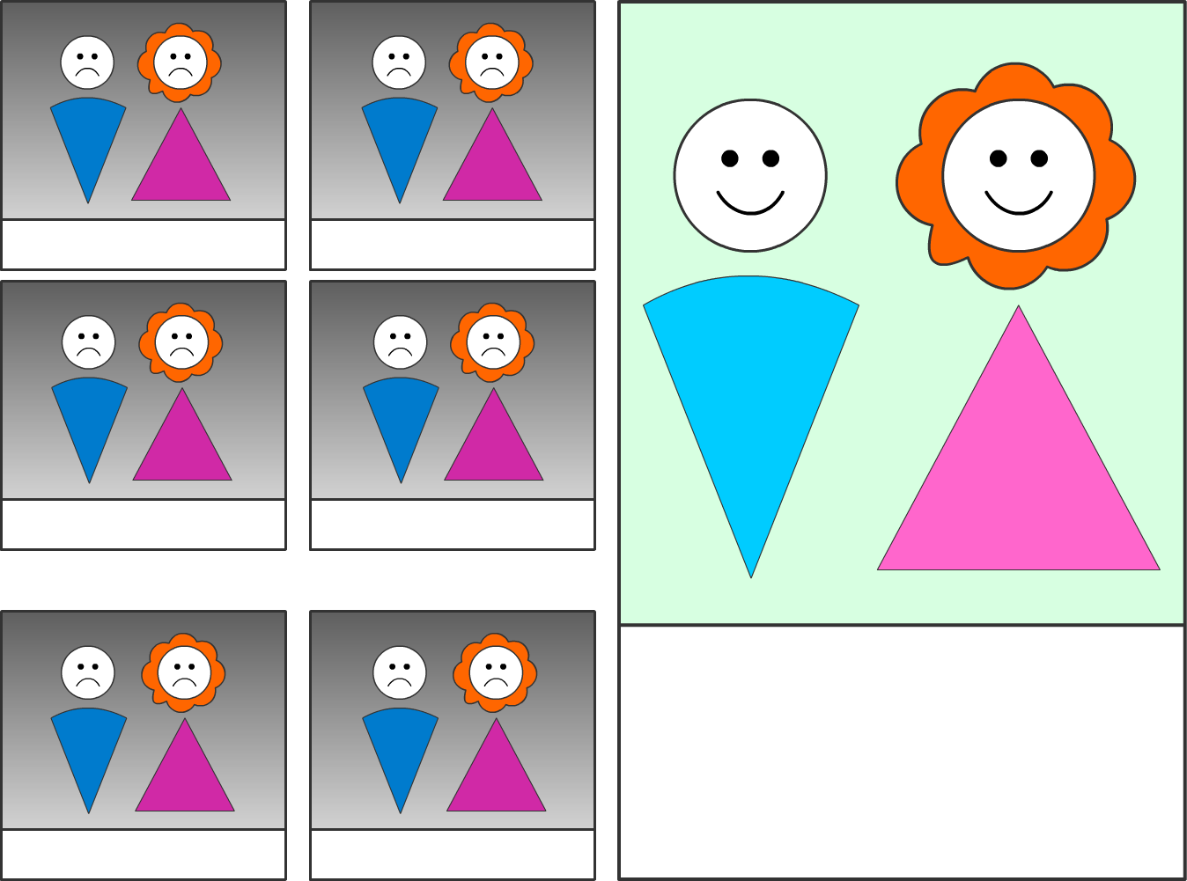
It is in fact, very easy to reject the null hypothesis
Lack of $
No Leisure Time
No Communication
Awful in-laws
Happiness requires positive fulfillment of all possible categories. Failure in any leads to unhappiness.
Scandals
Incompatibility

Slide 51
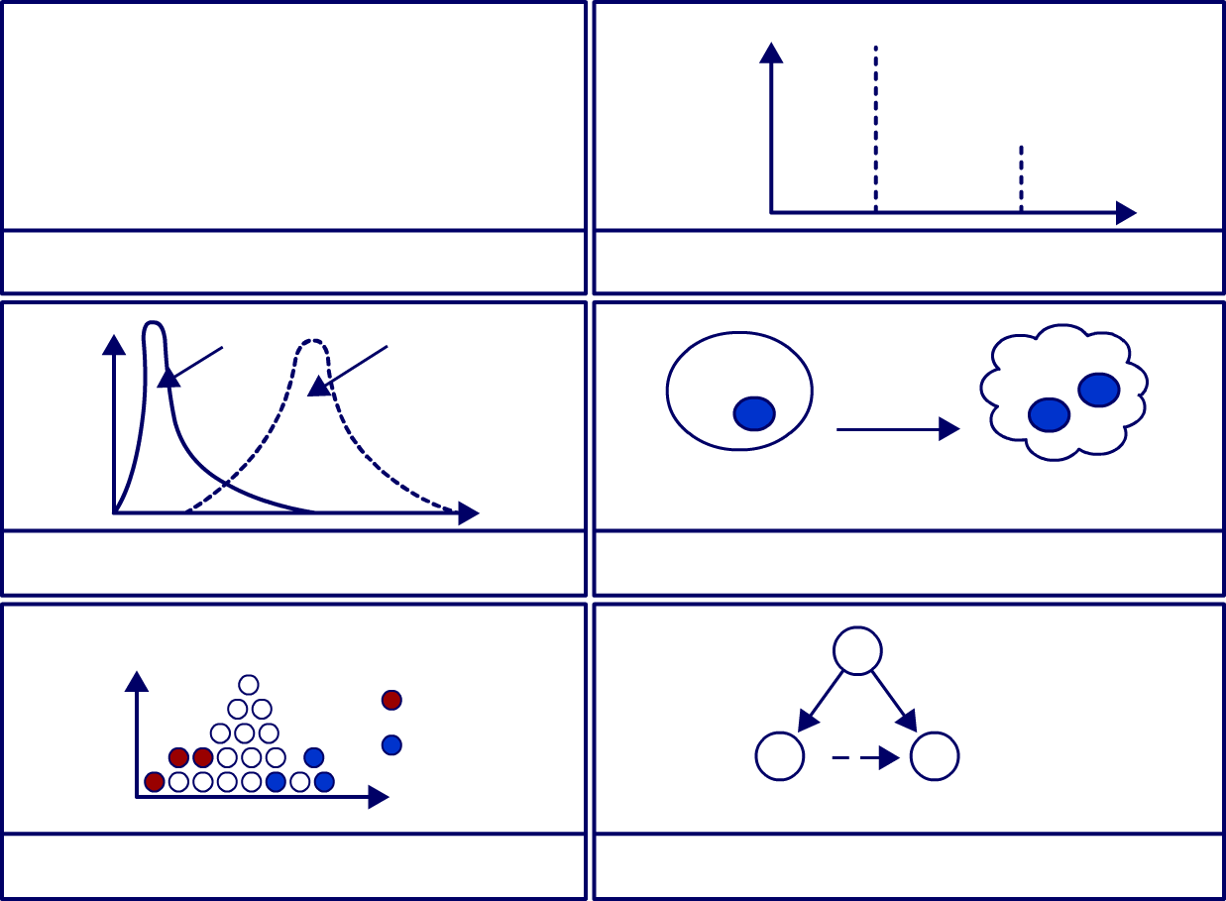
How this translates to biology
Monday
False Dichotomy
Null; Gene does not cause disease
Alternative: Gene causes disease
Abundance of gene A
Tuesday
Wrong Test Construction
Batch Effect
Observed
Theoretical
Change Gene A
Frequency
Normal
Diseased
Wrong Null Distribution
Gene is Relevant
A
True Cause
Draw 1
Frequency
Draw 2
B
X
C
Phenotype
B is reported but is merely correlated to A
Chance Association
Non-causal Association
Only 1 of the causes for null hypothesis rejection is the one we want.

Slide 52
Causes of Anna Karenina
Subpopulation Effects
Random Sampling Error
Wrong Null Distribution
Causes of Anna Karenina

Slide 53
Random Sampling Error – The Anna Karenina Principle IH7001 Introduction to Medical Research Dr Wilson Goh School of Biological Sciences

Slide 54
Random Sampling Error
Consider a gene rs123 with two alleles, A and G.
Original Null: rs123 alleles are identically distributed in the two populations.
Original Alternative: rs123 alleles are non-identically distributed in the two populations.
rs123 chi-square p-value = 4.78E-21
Genotypes | Controls [n(%)] | Disease [n(%)]
AA | 1 (0.9%) | 0 (0%)
AG | 38 (35.2%) | 79 (97.5%)
GG | 69 (63.9%) | 2 (2.5%)
Is this significant?
But is it true significance?

Slide 55
Sample from a Population
Consider what happens when we sample from a population:
Sample 1
Population
C | D
Sample 3
C | D
C | D
Sample 2
C | D
If the sample does not reflect the population, then the sampling bias will cause the statistical test to be significant.
So what’s happening here?

Slide 56
So…what can we do?
Let’s try rewriting the null hypothesis statements:
Refined Null: Distributions of rs123 alleles in the samples are reflective of their respective reference populations AND rs123 alleles are identically distributed in the two populations.
Intel claims to have been working with the 45nm chip with high-k metal gates since 2007.
Refined Alternative: Distributions of rs123 alleles in the sample are different from their reference populations OR rs123 alleles are non-identically distributed in the two populations.
In other words, if the first statement is satisfied, then rejection of the null must be because rs123 are non-identically distributed in the two populations.
But problem is, how do we know we have sampling bias?

Slide 57
Inferring the Population without Touching the Population
Can we measure all people on earth? Too expensive? Impossible. So does it mean I cannot confirm I have sampling bias?
Let’s look at our table again:
rs123 chi-square p-value = 4.78E-21
Genotypes | Controls [n(%)] | Disease [n(%)]
AA | 1 (0.9%) | 0 (0%)
AG | 38 (35.2%) | 79 (97.5%)
GG | 69 (63.9%) | 2 (2.5%)
N= 189
1/189 (<1%)
117/189 (62%)
71/189 (37.9%)

Slide 58
So what can we do with what we know?
So what can we do with what we know?
 | 62% of our samples are AG. So let’s say, the probability of a mother and a father both being AG is 0.62 * 0.62 = 0.38. And the probability of them having a child that is AA is 0.25 * 0.62 * 0.62 = 0.09 (9%).
Let’s use what we know about simple human genetics.
Let’s calculate backwards.
½ chance of getting a from father
A
a
AA
Aa
A
½ chance of getting a from mother
Aa
aa
Chance of BOTH events occurring
1 . 1 = 1
2 2 4
a
Basic rule of human genetics

Slide 59
Inferring Sampling Bias without the Population
Let’s look at our table again.
rs123 chi-square p-value = 4.78E-21
Genotypes | Controls [n(%)] | Disease [n(%)]
AA | 1 (0.9%) | 0 (0%)
AG | 38 (35.2%) | 79 (97.5%)
GG | 69 (63.9%) | 2 (2.5%)
<1% AA
1/189
62% AG
117/189
38% GG
71/189
N= 189
We expect 9%. But our data says AA is only < 1%. So unless AA is lethal, our samples do not reflect expectation. Therefore, we conclude that our samples are biased. And therefore, if we reject the null, we need to be careful of Anna Karenina.

Slide 60
Correlation and Causality
Refined H0
Refined H1
- Distributions of rs123 alleles in the two samples are identical to the two populations; and
- rs123 alleles are identically distributed in the two populations.
- Distributions of rs123 alleles in the two samples are different from the two populations; or
- rs123 alleles are differently distributed in the two populations.
Suppose distributions of rs123 alleles in the samples are identical to the populations and the test is significant. Can we say rs123 mutation causes the disease?

Slide 61
Three types of Reasoning
1
2
3
Induction
Socrates is a man.
Socrates is mortal.
All men are mortal (provided there is no counter example).
Abduction
All men are mortal.
Socrates is mortal.
Socrates is a man (provided there is no other explanation of Socrates’ mortality).
Deduction
All men are mortal.
Socrates is a man.
Socrates is mortal.

Slide 62
Which of the following are examples of each reasoning type?
Induction
Gene A performs function X; Gene B is sequentially similar to Gene A. Therefore, Gene B also performs function X.
Abduction
An apple is red, a car is red, so therefore a car is red.
Deduction
A class of proteins, C, performs function X. Protein Z is a member of C, so C must therefore perform function X.
Notes:
In the second example, we are generalising an observation to a rule. So this is induction. This is escapable because not all genes similar to A must have same function.
In the final example, we start with a rule, and zoom down to an observation. This is inescapable there is no way to get out of this rule.

Slide 63
Abduction in Action
Hypothesis: If rs123 mutation causes disease, the statistical test is significant.
Group
SNP | Genotypes | Controls [n(%)] | Cases [n(%)] | X² | P-value
rs123 | AA | 1 0.9% | 0 0.0% |  | 4.78E-21^{b}
 | AG | 38 35.2% | 79 97.5%
 | GG | 69 63.9% | 2 2.5%
SNP: Single Nucleotide Polymorphism
Observation: Statistical test is significant
Conclusion by abduction: rs123 mutation causes disease and provided there is no other explanation for the test to be significant.
That is, as long as this observation cannot be refuted, it may become a rule.
Notes:
Just because we hit significance, does not mean it is a cause.
Abductive reasoning can be disproven by finding a flaw in the explanation or in the evidence.

Slide 64
Correlation and Causality
Hypothesis: If rs123 mutation causes disease, the statistical test is significant.
Group
SNP | Genotypes | Controls [n(%)] | Cases [n(%)] | X² | P-value
rs123 | AA | 1 0.9% | 0 0.0% |  | 4.78E-21^{b}
 | AG | 38 35.2% | 79 97.5%
 | GG | 69 63.9% | 2 2.5%
SNP: Single Nucleotide Polymorphism
Observation: Statistical test is significant
Conclusion by abduction: rs123 mutation causes disease and provided there is no other explanation for the test to be significant.
How to incorporate “provided there is no other explanation” into the analysis?

Slide 65
How about this?
H0 - In some stratification:
H1 - In every stratification:
- Distributions of rs123 alleles in the two samples are identical to the two populations; and
- rs123 alleles are identically distributed in the two populations.
- Distributions of rs123 alleles in the two samples are different from the two populations; or
- rs123 alleles are differently distributed in the two populations.
This basically says there is “no exception”. It does not say there is “no other explanation”.

Slide 66
How about this?
Choose a sample of Cases and a sample of Controls such that for each stratification p1/p2, the distribution of p1/p2 in Cases is same as the distribution of p1/p2 in Controls i.e. equalise/ control for other factors.
Then test:
H0: X’s alleles are identically distributed in the two samples.
H1: X’s alleles are differently distributed in the two samples.
This makes the significance of the test independent of other explanations.
It still does not say “no other explanation”.

Slide 67
Or this?
Look for another gene X such that:
H0:
Distributions of X’s alleles in the two samples are identical to the two populations; and
X’s alleles are identically distributed in the two populations.
H1:
Distributions of X’s alleles in the two samples are different from the two populations; or
X’s alleles are differently distributed in the two populations.
When the red part of H1 is false, this implies gene X mutation is an alternative explanation for the significance of rs123 mutation and thus the disease.
In this case, rs123 is clearly not a cause. But has to be considered in light of its relationship with X.

Slide 68
Subpopulation Effects – The Anna Karenina Principle IH7001 Introduction to Medical Research Dr Wilson Goh School of Biological Sciences

Slide 69
A Seemingly Obvious Conclusion
Overall
 | A | B
Lived | 60 | 65
Died | 100 | 165
 | 0.60 | 0.39
Women
 | A | B
Lived | 40 | 15
Died | 20 | 5
 | 2 | 3
Men
 | A | B
Lived | 20 | 50
Died | 80 | 160
 | 0.25 | 0.31
Looks like treatment A is better.
But splitting the data by gender results in a reversal. Looks like treatment B is better.
In this case, the trouble arises because the proportion of men and women are not equalised the two samples.

Slide 70
Careless Null Hypothesis
“Effective” H0: Treatments are identically distributed in the two samples.
Apparent H0: Treatments are identically distributed in the two populations.
Apparent H1: Treatments are differently distributed in the two populations.
Assumption: All other factors are equalised in the two samples.

Slide 71
Refined Null Hypothesis
Refined H0:
Refined H1:
All other factors are equalised in the two samples; and
Some factors are not equalised in the two samples; or
Treatments are identically distributed in the two samples.
Treatments are differently distributed in the two populations.
Any other thing missing?

Slide 72
A/B sample not equalised in other attributes, viz. sex
Overall
 | A | B
Lived | 60 | 65
Died | 100 | 165
Women
 | A | B
Lived | 40 | 15
Died | 20 | 5
Men
 | A | B
Lived | 20 | 50
Died | 80 | 160
Taking A
Men = 100 (63%)
Women = 60 (37%)
Taking B
Men = 210 (91%)
Women = 20 (9%)
The differences in proportion in A and B between the two genders is contributing to false effects. The simplest way to deal with this is to simply ensure that the gender proportion is the same in both A and B.

Slide 73
Wrong Null Distribution – The Anna Karenina Principle IH7001 Introduction to Medical Research Dr Wilson Goh School of Biological Sciences

Slide 74
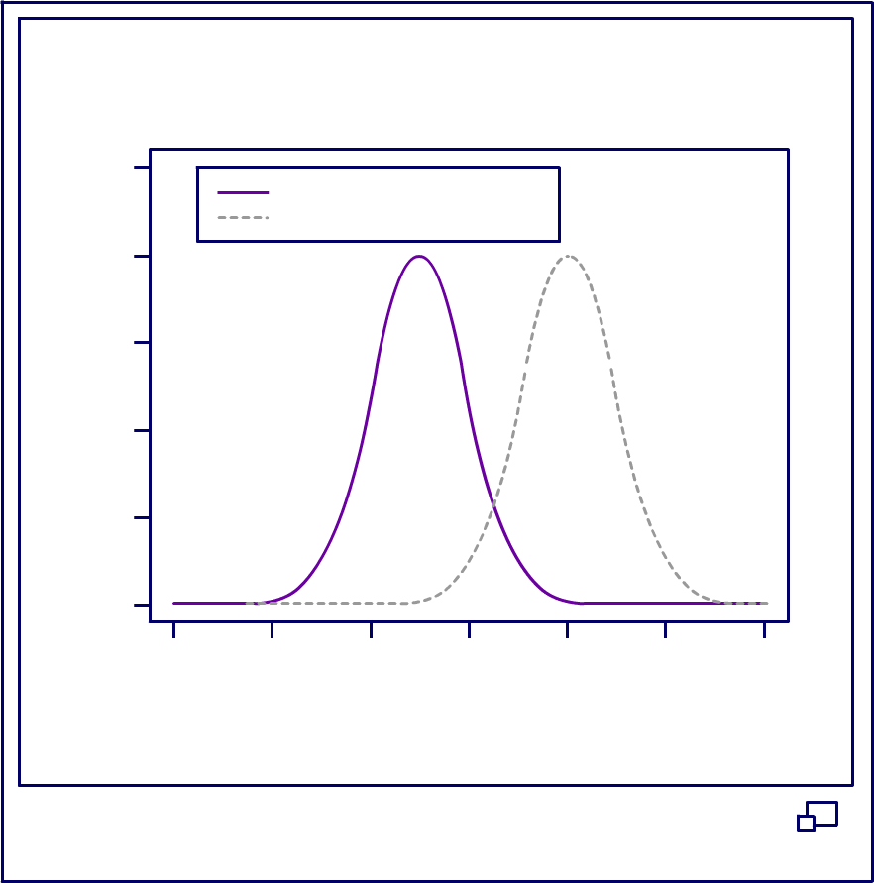
Null Distribution
In statistical hypothesis testing, the null distribution is the probability distribution of the test statistic when the null hypothesis is true. For example, in an F-test, the null distribution is an F-distribution.
0.5
Null Distribution
Alternative Distribution
0.4
0.3
Density
0.2
0.1
0.0
-6
-4
-2
0
2
4
6
X
Null and Alternative Distribution

Slide 75
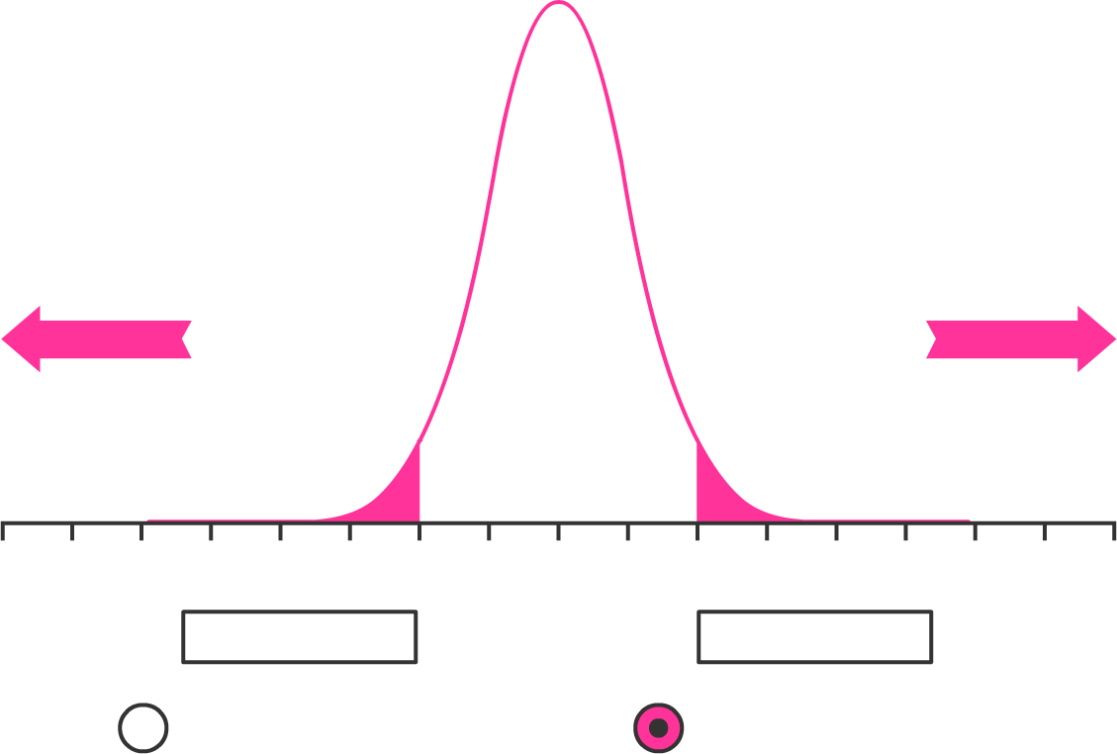
Appropriateness of the Null Distribution is Important
t distribution with df = 8
df
t_{0.1}
t_{0.05}
t_{0.025}
t_{0.01}
t_{0.005}
2
3
10
20
30
100
400
1.89
1.64
1.37
1.33
1.31
1.29
1.28
2.92
2.35
1.81
1.72
1.7
1.66
1.65
4.3
3.18
2.23
2.09
2.04
1.98
1.97
6.96
4.54
2.76
2.53
2.46
2.36
2.34
9.92
5.84
3.17
2.85
2.75
2.63
2.59
-8
-7
-6
-5
-4
-3
-2
-1
0
1
2
3
4
5
6
7
8
∞
z_{0.1}
z_{0.05}
z_{0.025}
z_{0.01}
z_{0.005}
df:
8
1.96
1.28
1.645
1.96
2.33
2.58
t:
One-tailed Test
Two-tailed Test
Shaded Area: 0.0857

Slide 76
Degrees of Freedom (DOF)
As the Degrees of Freedom (DOF) increases:
The AUC becomes smaller, making it easier to reject the null hypothesis (higher false positives).
The DOF is a reflection of the confidence we have with larger sample sizes.

Slide 77
Suitable Null Distribution is Important
The smaller sample size is, the lower the DOF, and the flatter the t-distribution becomes, making it harder to reject the null hypothesis.
This dynamic adaption of the null distribution to small sample size is important: when sample size is small, we make less reliable estimates of population parameters from sample; a flatter t-distribution means that given this increased uncertainty, we do not reject the null hypothesis as easily.

Slide 78
Types of Null Distributions
Null-model fitting may be broadly divided into parametric (e.g. when the data distribution approximates a bell curve) or non-parametric (e.g. when the data distribution does not approximate a bell curve).
In both scenarios, there are extensive criteria to fulfill: just because the data is not bell-curve like, does not mean it is compatible for use with non-parametric methods (e.g. balanced design with sufficient sample size; and similar distribution shapes between both populations).
*On what basis can I claim that to be true?

Slide 79
Breast Cancer Biomarkers:
Wrong Null Distribution IH7001 Introduction to Medical Research Dr Wilson Goh School of Biological Sciences

Slide 80
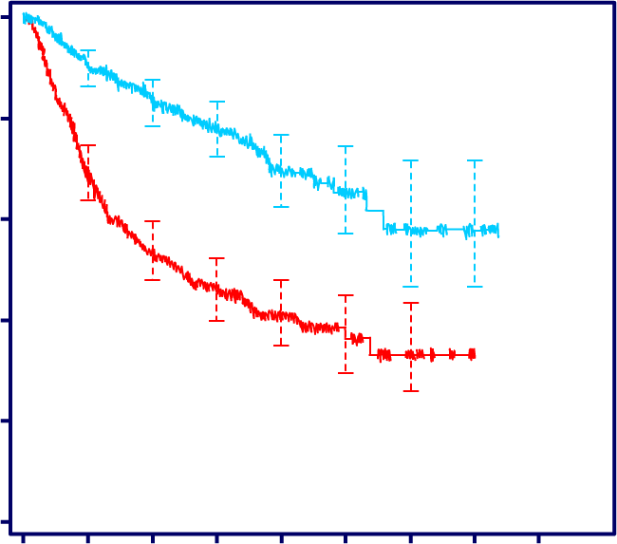
A seemingly Obvious Conclusion
A multi-gene signature is claimed as a good biomarker for breast cancer survival - Cox’s survival model p-value << 0.05.
100
80
60
GG1
Relapse-free survival (%)
40
GG3
20
GG3 vs. GG1 :
HR = 2.83 [CI 2.13 – 3.77]
P < 0.001 (logrank test)
0
0
2.5
5
7.5
10
12.5
15
17.5
20
Time (years)
Number at risk
A straightforward Cox’s proportional hazard analysis. Anything more/wrong?
GG1 279 242 206 123 59 26 12 3
GG3 291 191 139 83 39 18 4
total 570 434 345 206 98 44 16 3

Slide 81
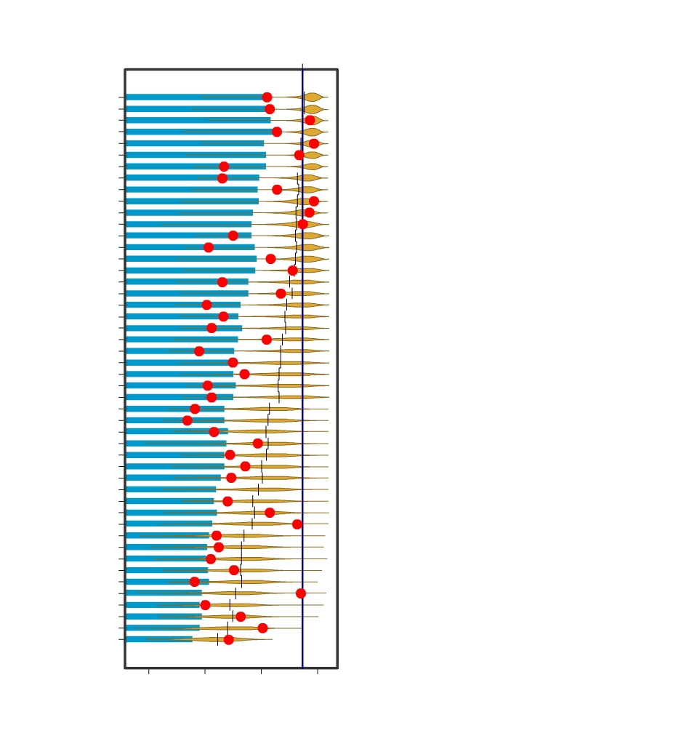
Almost all Random Signatures also have p-value < 0.05
Log₁₀(0.05)
PEI
ADORNO
WELM
BUFFA
VALASTYAN
TAVAZOIE
HE
GLINSKY
HU
YU
SORLIE
RAMASWAMY
PAIK
IVSHINA
Theoretical null distribution used in Cox’s proportion hazard analysis does not match the empirical null distribution.
What can we do about this?
MILLER
KORKOLA
MA
BUESS
DAI
WONG-PROTEAS
PAWITAN
SHIPITSIN
VANTVEER
RHODES
WANG-76
CARTER
HALLSTROM
SOTIRIOU-GGI
ABBA
META-PCNA
CHI
MORI
SAAL
LIU
KOK
WONG-MITOCHON
WANG-ALK5T204D
TAUBE
WONG-ESC
SOTIRIOUS-93
CHANG
BEN-PORATH-EXP1
CRAWFORD
WEST
WHITEFIELD
BEN-PORATH-PRC2
REUTER
HUA
-15
-10
-5
0
P-value (log₁₀)
Venet et al., PLOS Comput Biol, 2011

Slide 82
Wrong Null Distribution
“Effective” H0: The biomarker’s values are identically distributed in the two populations.
Apparent H0: The biomarker’s values are identically distributed in the two populations.
Apparent H1: The biomarker’s values are differently distributed in the two populations.
Assumption: The null distribution models real world.

Slide 83
Wrong Null Distribution
“Effective” H0: The biomarker’s values are identically distributed in the two populations.
Apparent H0: The biomarker’s values are identically distributed in the two populations.
Apparent H1: The biomarker’s values are differently distributed in the two populations.
Assumption: The null distribution models real world.
The apparent null / alternative hypothesis is carelessly stated. Why? How to fix this?

Slide 84
Refined Null Hypothesis
Refined H0:
Refined:
The biomarker’s values are identically distributed in the two populations; and
The null distribution models real world.
The biomarker’s values are differently distributed in the two populations; or
The null distribution does not model real world.

Slide 85
But how to model the null?
One option exists, in the form of Permutation Tests (PT) where the sampling distribution is constructed by resampling the observed data, subject to a crucial assumption of exchangeability of the samples under the null hypothesis.
That is, the reference distribution is constructed by observed data itself, and in a manner that is consistent with the null hypothesis.
This is called the empirical distribution (as opposed to the null distribution, which is inferred independently and theoretically).
Note that, by construction, this empirical distribution is appropriate for the issue at hand only when the null hypothesis itself is appropriate.

Slide 86
Permutation Tests
In PT, data are randomly re-assigned a class label so that an exact p-value is calculated based on the permutated data (empirical-based resampling).
A crucial assumption that should not be overlooked when using this kind of test is the assumption of exchangeability of the samples under the null hypothesis.
The null hypothesis has to permit class labels to be swapped.

Slide 87
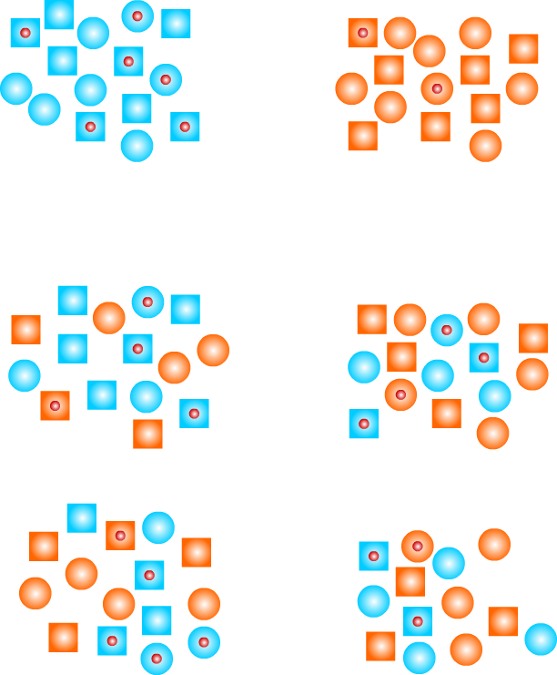
Permutation Tests
Actual Data Set
Cases
Controls
Calculate test statistics of interest in actual data set.
Permutes Data
‘Cases’
‘Controls’
To obtain significance of best actual test statistic compare with distribution of best permuted statistics.
Calculate same test statistics in each permuted data set and record best result for each permutation
Nature Reviews I Genetics
Source: https://www.ncbi.nlm.nih.gov/pubmed/15716906

Slide 88
Permutation Test
Randomisation exact test is a test procedure in which data are randomly re-assigned so that an exact p-value is calculated based on the permutated data.
Original Scores of two groups
Web-based |  | Text-based
Subject | Scores | Subject | Scores
Jody | 99 | Alex | 87
Sandy | 90 | Andy | 89
Barb | 93 | Candy | 97
More subjects… | More scores… | More subjects… | More scores…
Let's look at the above example. Assume that in an experiment comparing web-based and text-based instructional methods, subjects obtained the given scores:

Slide 89
Permutation Test
Let’s say we do a two-sample t-test, the test returns a t-score of 1.55.
In parametric statistics, we check the t-score against the critical value in the t-distribution to determine whether the group difference is significant.
In resampling statistics, instead of checking the theoretical t-distribution, we can reframe analysis into a "what-if" question.
Maybe It may just happen that Jody, the over-achiever, takes the Web-based version by chance, and Alex, the under-achiever, takes the text-based version by chance, too. What if their positions are swapped?"
We can reframe this question by swapping the class labels (web-based and text-based). Let’s see what the new table will look like.

Slide 90
Permutation Test
We can do this to get all possible rearrangements of the data. This re-sample by random swapping is called “permutated data”.
Permutated Scores of two groups
Web-based |  | Text-based
Subject | Scores | Subject | Scores
Alex | 87 | Jody | 99
Sandy | 90 | Andy | 89
Barb | 93 | Candy | 97
More subjects… | More scores… | More subjects… | More scores…
Note that in permutations tests, the order don’t really matter. So they really are all about combinations! (The name is misleading).

Slide 91
Permutation Test
We compute the permutated data and obtains another t-value of -0.64. If we keep swapping observations across the two groups, many more t-values will be returned.
The purpose of this procedure is to artificially simulate "chance”. Sometimes the t is large, but other times it is small. After exhausting every possibility, say 100, the inquirer can put these t-scores together to plot an empirical distribution curve, which is built on the empirical sample data.
When the t-score of 1.55 (observed t-score) is exceeded by permutated t-statistics 5 times out of 100 times, the researcher can conclude that the exact p-value (the probability that this difference happens by chances alone) is 0.05.
Since we compares the observed t-score with the empirical t-distribution, the latter becomes the reference set.
Other types of resampling are based on the same principle: repeated experiments within the same dataset.
Please note that the underlying principles of this randomisation test and a parametric t-test are closely related because the two are equivalent asymptotically (we are using the same test-statistic but the reference distribution is generated via permutation).
Is this still a parametric test?

Slide 92
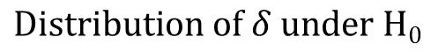
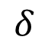
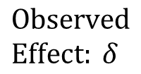
Permutation Test
Data
Test Statistic
$$Observed \\ Effect: δ$$
*
$$δ$$
*
Model of H₀
Simulated Data
$$Distribution of δ under H0$$

Slide 93
Live demo on a permutation test
Using the simple one on binary data

Slide 94
Back to the Venet Example
Log₁₀(0.05)
PEI
ADORNO
WELM
BUFFA
VALASTYAN
TAVAZOIE
HE
GLINSKY
HU
YU
SORLIE
RAMASWAMY
PAIK
IVSHINA
Green lines are the 5% most significant random signatures.
Define away the problem… is that a valid solution?
MILLER
KORKOLA
MA
BUESS
DAI
WONG-PROTEAS
PAWITAN
SHIPITSIN
VANTVEER
RHODES
WANG-76
CARTER
HALLSTROM
SOTIRIOU-GGI
ABBA
META-PCNA
CHI
MORI
SAAL
LIU
KOK
WONG-MITOCHON
WANG-ALK5T204D
TAUBE
WONG-ESC
SOTIRIOUS-93
CHANG
BEN-PORATH-EXP1
CRAWFORD
WEST
WHITEFIELD
BEN-PORATH-PRC2
REUTER
HUA
-15
-10
-5
0
P-value (log₁₀)
Venet et al., PLOS Comput Biol, 2011
Notes:
Using the empirical distribution formed by the nominal p-values (computed based on the nominal null distribution and the given set of patients) of random signatures, and when no more than 5% of the random signatures have nominal p-values smaller than the observed nominal p-value of the signature being tested, that signature is declared significant. In some sense, this defined away the problem, as no more than 5% of random signatures get declared significant by the construction of this procedure.

Slide 95
A final word on biomarker identification and validation IH7001 Introduction to Medical Research Dr Wilson Goh School of Biological Sciences

Slide 96
Putting together an analysis pipeline may look like this:
Realize that we’ve barely scratched the surface in what constitutes an entire analysis framework?

Slide 97
A short introduction to exploratory data science and the grammar of graphics IH7001 Introduction to Medical Research Dr Wilson Goh School of Biological Sciences

Slide 98
Open Swirl Tutorial
Instruction to be given in class

Slide 99
Things to note:
Analyzing data is difficult.
Real-world data is complex, with many lurking variables that may confound analysis.
It is important to be aware of these when interpreting findings from any statistical analysis

Slide 100
Please do this
When done with the tutorial

Slide 101
What are you required to remember?
Need to be able to differentiate between the 3 forms of logic
Explain what a confounder is
Be able to identify scenarios of perfect confounding
Be able to explain the Anna Karenina Principle
Be able to explain the importance of exploratory data analysis
Be able to identify several retinal variables taught during the R tutorial
You do not need to be able to know the following in detail
Permutation test --- you only need to know that it is another way of generating a null distribution by randomly permutating the original dataset itself
All the steps involved in a complete analysis of data for the purpose of biomarker prediction

Slide 102
Must read
Goh and Wong. Dealing with confounders in -omics analysis. Trends in Biotechnology, 36(5):488--498, May 2018.
Goh et al. Why batch effects matter in omics data, and how to avoid them. Trends in Biotechnology, 35(6):498--507, June 2017.
Venet et al. Most Random Gene Expression Signatures Are Significantly Associated with Breast Cancer Outcome, PLOS Comp Bio, 1002240, Oct 2011.

Slide 103
Good to read
Goh and Wong. Why breast cancer signatures are no better than random signatures explained. Drug Discovery Today, 2018.
Goh and Wong. Turning straw into gold: building robustness into gene signature inference. Drug Discovery Today, 2019.
Wasserstein and Lazer. The ASA's Statement on p-Values: Context, Process, and Purpose. The American Statistician, 70:2, 129-133, 2016
Halsey et al. The fickle P value generates irreproducible results. Nature Methods 12, 179–185, 2015
Wang et al. Feature selection in clinical proteomics: with great power comes great reproducibility. Drug Discov Today. Jun;22(6):912-918, 2017

